Slide 1
CIS8695: Managing Big Data Analytics
Nasim Mousavi
Assistant Professor
J. Mack Robinson College of Business
Georgia State University
nmousavi@gsu.edu

Slide 2
Logistic Regression

Slide 3
Logistic Regression
Extends the idea of linear regression to situation where outcome variable is categorical
Linear regression
Predict the value of the continuous Y for a new observation
Logistic regression
Predict which class a new observation will belong to

Slide 4
Applications
Whenever a structured model is needed to explain or predict a categorical, particularly, binary outcome
i.e. Y=0 or Y=1
Widely used in various applications:
Classifying customers as returning or non-returning (classification)
Predicting the approval or disapproval of a loan based on information such as credit scores (profiling)
Finding factors that differentiate between male and female top executives (classification)
We focus on classification with a binary outcome (2 classes)

Slide 5
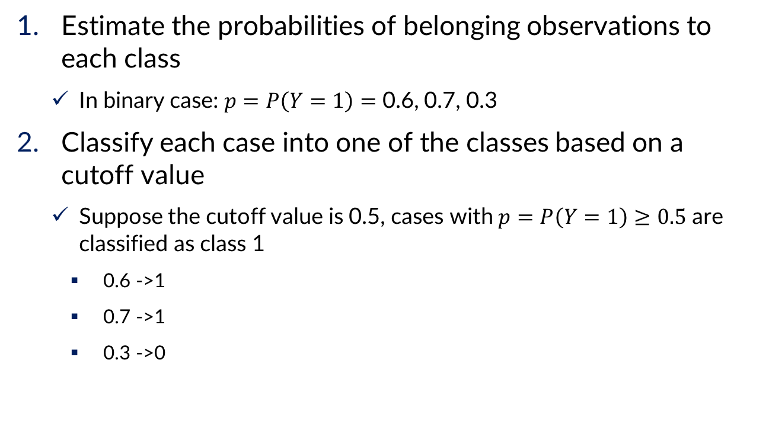
Two Steps of Logistic Regression
Estimate the probabilities of belonging observations to each class
In binary case: $p=P\left(Y=1\right)=$ 0.6, 0.7, 0.3
Classify each case into one of the classes based on a cutoff value
Suppose the cutoff value is 0.5, cases with $p=P\left(Y=1\right)≥0.5$ are classified as class 1
0.6 ->1
0.7 ->1
0.3 ->0

Slide 6
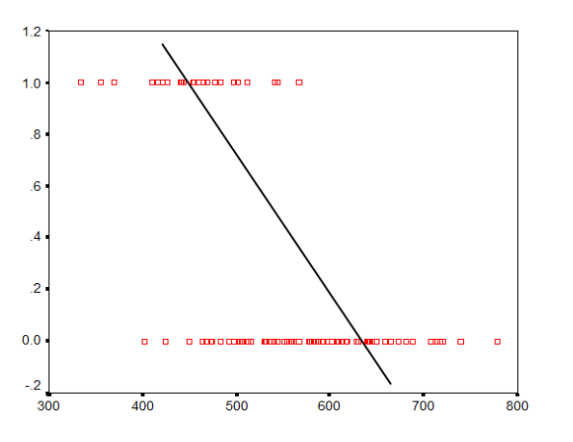

The Logistic Regression Model
We cannot use $Y$ as outcome variable (like in linear regression)
If we use $Y$ as the outcome variable to fit a line, it wouldn’t be a very good representation of the relationship

Slide 7
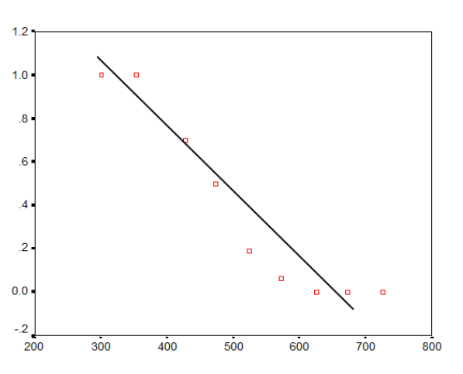

The Logistic Regression Model
But if we use the probability of class ($p=P\left(Y=1\right))$ as the dependent variable
It’s closer to being linear, but it’s still not quite there
Instead of a linear relationship between X and $p$, we need a function than can explain the S-shaped relationship

Slide 8

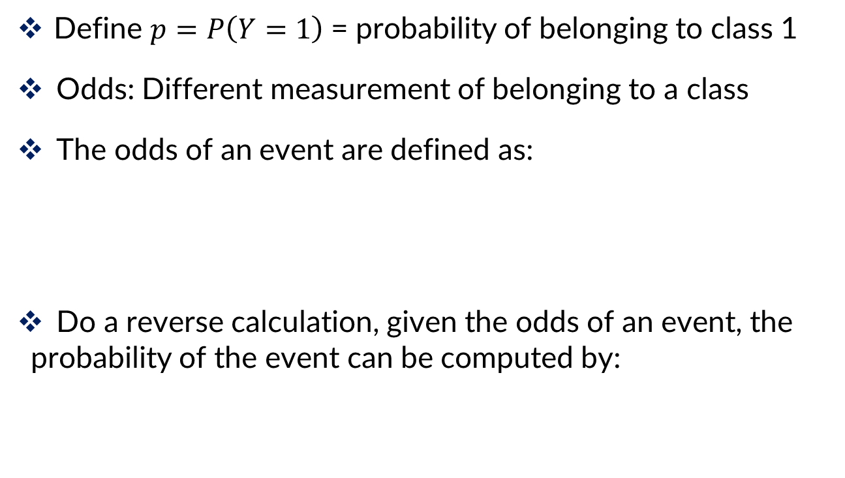
Introduction of Terms
Define $p=P\left(Y=1\right)$= probability of belonging to class 1
Odds: Different measurement of belonging to a class
The odds of an event are defined as:
Do a reverse calculation, given the odds of an event, the probability of the event can be computed by:
$$Odds\left(Y=1\right)=\frac{p}{1−p}$$
Probability of belonging to class 1
Probability of belonging to class 0

Slide 9
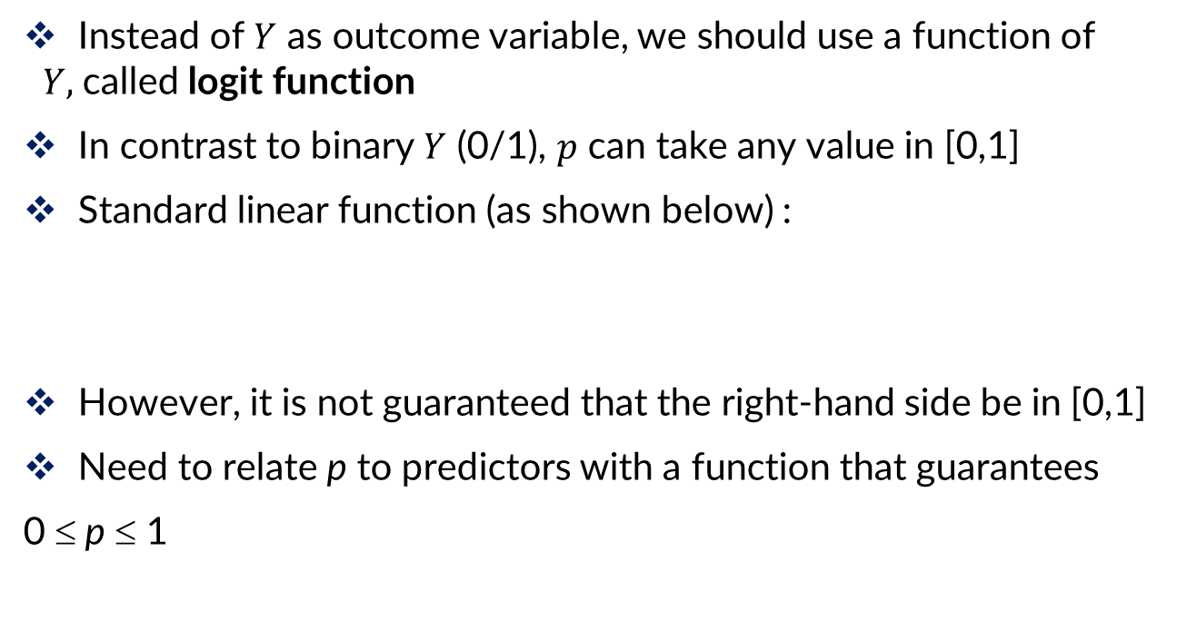
The Logistic Regression Model
Instead of $Y$ as outcome variable, we should use a function of $Y,$called logit function
In contrast to binary $Y$ (0/1), $p$ can take any value in [0,1]
Standard linear function (as shown below) :
However, it is not guaranteed that the right-hand side be in [0,1]
Need to relate p to predictors with a function that guarantees
0 ≤ p ≤ 1

Slide 10
Solution
Use a nonlinear function of the predictors
Rewrite:
logistic response function

Slide 11
Solution
Substitute:
Into:
Results in:
$$Odds\left(Y=1\right)=e^{β_{0}+β_{1}x_{1}+…+β_{q}x_{q}}$$

Slide 12
Relate Odds to Predictors
$$Odds\left(Y=1\right)=e^{β_{0}+β_{1}x_{1}+…+β_{q}x_{q}}$$
Logit = Log(Odds)
So, the logit is a linear function of predictors
Takes values from -infinity to +infinity

Slide 13
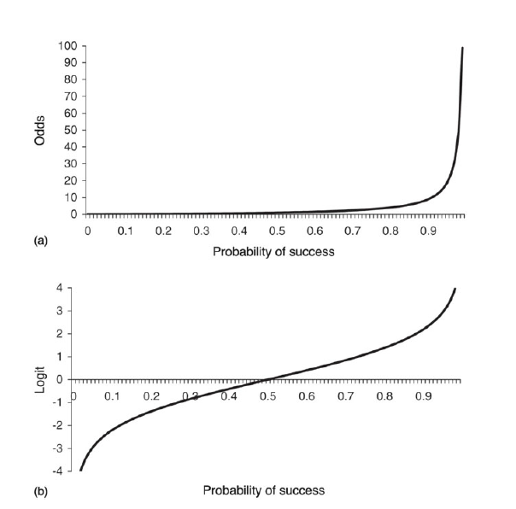

Odds and Logit as a Function of $p$
Can take only non-negative value
Can take any real value

Slide 14
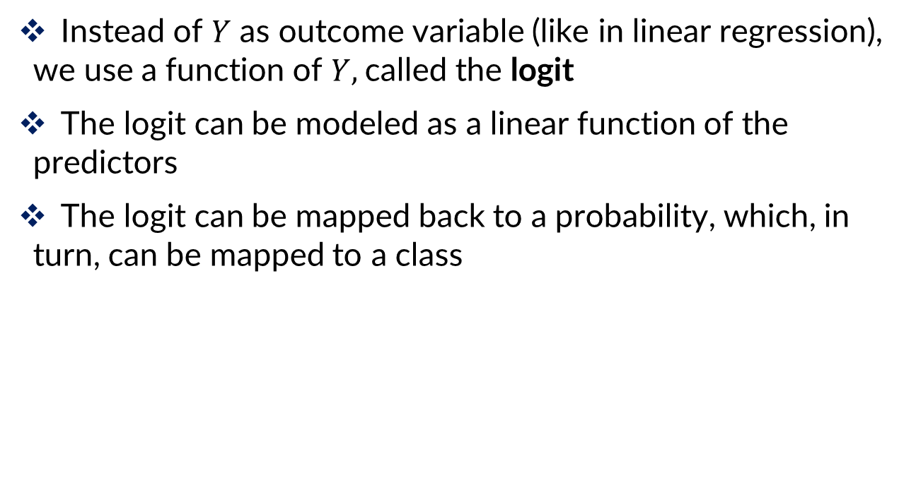
Summary of Logistic Regression
Instead of $Y$ as outcome variable (like in linear regression), we use a function of $Y,$called the logit
The logit can be modeled as a linear function of the predictors
The logit can be mapped back to a probability, which, in turn, can be mapped to a class
Logit
Probability
Class

Slide 15
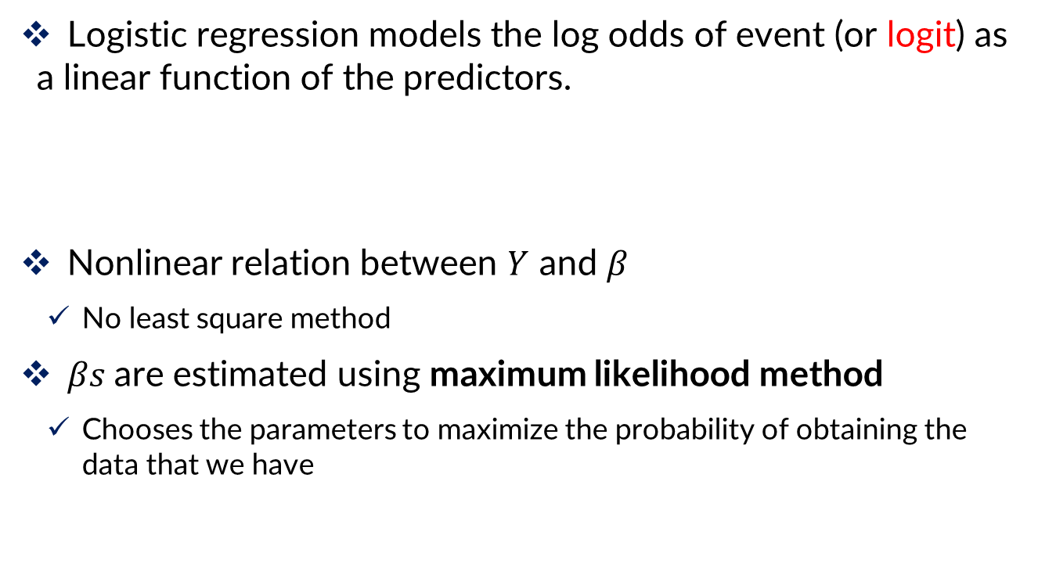
Logistic Regression
Logistic regression models the log odds of event (or logit) as a linear function of the predictors.
Nonlinear relation between $Y$ and $β$
No least square method
$βs$are estimated using maximum likelihood method
Chooses the parameters to maximize the probability of obtaining the data that we have

Slide 16
Ways to Determine Cutoff
0.5 is popular initial choice
Additional considerations (see Chapter 5)
Maximize classification accuracy
Maximize sensitivity (subject to min. level of specificity)
Minimize false positives (subject to max. false negative rate)
Minimize expected cost of misclassification (need to specify costs)

Slide 17
Example

Slide 18
Personal Loan Offer
Goal: identify customers who are more likely to accept the loan offer in future mailings
Outcome variable: accept loan (0/1)
Predictors: Their last response to loan campaign, demographic info (Age, income, etc.), customers’ relationship with bank (mortgage, securities account, etc.)

Slide 19
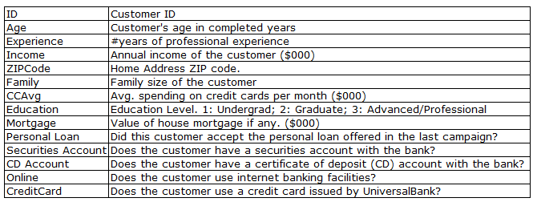
Personal Loan Offer

Slide 20
Data Preprocessing
Similar to linear regression
Missing values
Categorical inputs
Nonlinear transformations of inputs
Variable selection (including avoiding multicollinearity)

Slide 21
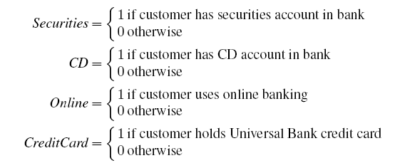
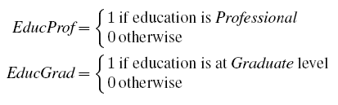
Data preprocessing
Create 0/1 dummy variables for categorical predictors
Partition 60% training, 40% validation

Slide 22

Example, continued
Logistic regression output gives coefficients for the logit, as well as odds for the individual terms
For predictive classification, we typically use probability with a cutoff value
For explanatory purposes, odds have a useful interpretation:
If we increase x₁ by one unit, holding x₂, x₃ … x_{q} constant, then e^{β} is the factor by which the odds of belonging to class 1 increase
$$Odds\left(Personal Loan=Yes\right)=e^{logit}$$

Slide 23
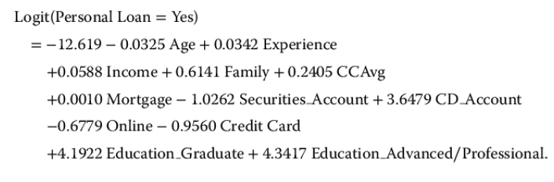
Example, continued
What does the coefficient tell us? (like education_graduate)
Having graduate education is associated with higher probabilities of accepting the loan offer

Slide 24

Example, continued
What does the coefficient tell us, in terms of odds? (like CD account)
$e^{3.6479}$= 38.4 are the odds that a customer who has a CD account will accept the offer relative to a customer who does not have a CD account, holding all other variables constant

Slide 25
Evaluating Classification Performance
Performance measures
Confusion matrix
% of misclassifications
Use the estimated equation to predict the probability of class membership for each record in the validation set
Then compare these classifications with the actual class memberships to measure the accuracy

Slide 26
Evaluating Classification Performance
Confusion matrix
Note that all predictions: All = TP + FP + FN + TN
Some common metrics:
Accuracy = (TP + TN) / All
Precision = TP / (TP + FP: predicted positive)
Recall (Sensitivity) = TP / (TP + FN: actual positive)
Specificity = TN / (TN + FP)
Actual | Predicted
 | Positive, 1 | Negative, 0
Positive, 1 | True Pos. (TP) | False Neg. (FN)
Negative, 0 | False Pos. (FP) | True Neg. (TN)

Slide 27
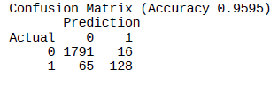

Evaluating Classification Performance
$$Accuracy= \frac{TP+TN}{All}=\frac{1791+128}{2000}=0.9595$$

Slide 28
Variable Selection
This is the same issue as in linear regression
The number of correlated predictors can grow when we create derived variables such as interaction terms (e.g. Income x Family), to capture more complex relationships
Problem: Overly complex models have the danger of overfitting
Solution: Reduce variables via automated selection of variable subsets (as with linear regression)

Slide 29
Summary
Logistic regression is similar to linear regression, except that it is used with a categorical response.
It can be used for explanatory tasks (=profiling) or predictive tasks (=classification).
The predictors are related to the response Y via a nonlinear function called the logit.
As in linear regression, reducing predictors can be done via variable selection.
Logistic regression can be generalized to more than two classes.

Slide 30
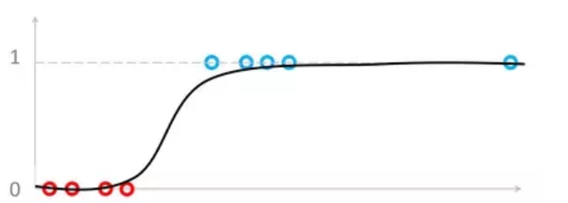
Question
Which of the linear regression and logistic regression is more robust to outliers? Why?
Answer: Logistic regression is more robust than the linear regression, because it is bounded between 0 and 1

Slide 31
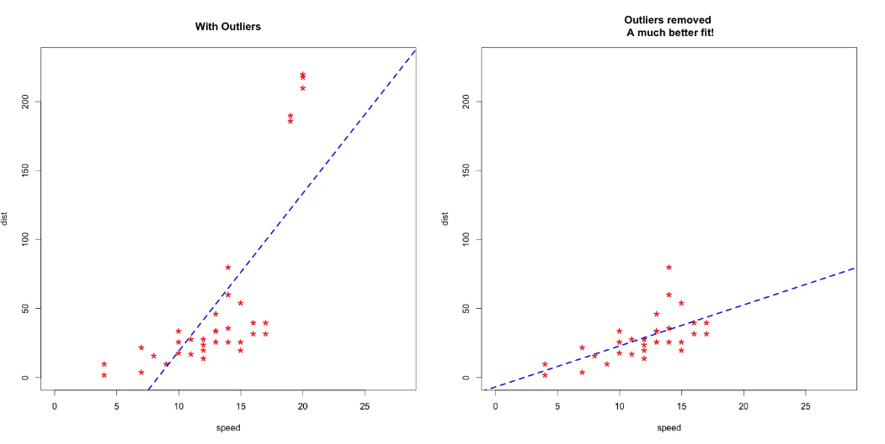
Question
While in linear regression, we focus on mean and outliers can significantly change the mean
However, keep in mind that this does not mean that having outliers in logistic regression is acceptable

